Slide 1
Census Data Analysis using Hadoop Framework
-Magesh M

Slide 2


Slide 3
BIG DATA
It is a collection of large datasets that cannot be processed using traditional computing techniques.
BIG DATA involves 5V’s
Volume
Velocity
Vareity
Veracity
Value

Slide 4


Slide 5
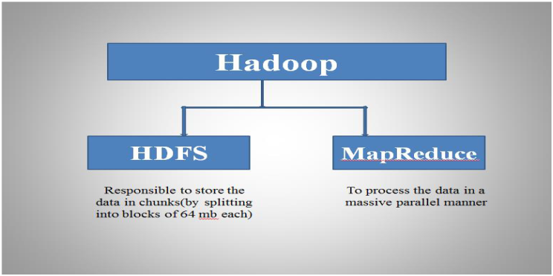
Apache Hadoop A Reliable shared storage and analysis system

Slide 6
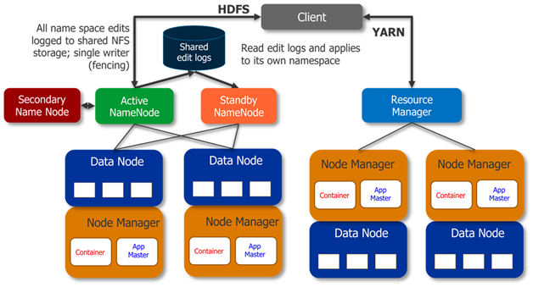
HDFS and YARN Architecture

Slide 7
Components of Hadoop
Pig
Hive
HBase
Flume
Sqoop
Zookeeper
Oozie

Slide 8
Project Content
JOB 1: Conversion of JSON file format to CSV file format.
Tool used: Apache Pig.
Step 1: Loading JSON file into Pig Grunt Shell in MapReduce mode.
Step 2: Storing Converted csv file into HDFS
JOB 2: Finding number of adults, middle aged and senior citizen to find ages between 14 to 64, where government can create employment. Tool used: Apache Pig.
Step 1: Loading the data from HDFS in mapreduce mode.
Step 2: Creating partition bags based on ages between 14 and 65 from employment bag using split command.
Step 3: Storing the processed data into HDFS.
Job 3: Finding Number of Unemployed Graduates.
Tool Used: Apache Pig.
Step 1: Loading the Data into Pig Grunt Shell in mapreduce mode.
Step 2: Filtering employent data with weeksworked as 0 and education as ' Bachelors degree(BA AB BS)';

Slide 9
Step 3: Grouping the data with the education column. Step 4: Counting number of unemployed graduates. Job 4: Finding number of citizens getting retired in next 3 years in gender wise. Tool Used: Apache Hive. Step 1: Creating database in Hive and using it. Step 2: Adding jar file for Hive process. Step 3: Creating tables inside the Project database. Step 4: Loading data into the created hive table. Step 5: Writing hive query to find the citizens retiring after three years. Job 5: Calculating PF for employed citizens. Tool Used: Apache MapReduce Step1: Writing Mapreduce code for calculating PF of all citizen. Step2 : Adding external jar files and export the file as jar file. Step 3: Running jar file in hadoop using jar command.

Slide 10
Project Analysis
Splitting the ages and taking count of people for whom, the government can offer jobs.
Making count of unemployed graduates who are eligible for working, so that the government can create job opportunities.
Making count of people who will get retired in next 3 years, so that government can allocate jobs for future graduates.
Making report on PF amount for all citizens based on their salary.

Slide 11
Thank You

